Slide 1
Bike trip planning in NYC using Foursquare and Machine Learning techniques
Silvia M.

Slide 2
Objective
Suggesting a procedure to plan a bike trip in New York City, using the existing Citi Bike network and exploiting:
Data from past months
Foursquare explore feature, to find venues and point of interests close to the possible end stations of the trip
KMeans algorithm, to identify patterns and common elements of the end stations

Slide 3
Sources of Data
JSON file of bike stations
https://feeds.citibikenyc.com/stations/stations.json
Citi Bike website
https://www.citibikenyc.com/system-data
Spreadsheet of monthly trips
201807-citibike-tripdata.csv

Slide 4
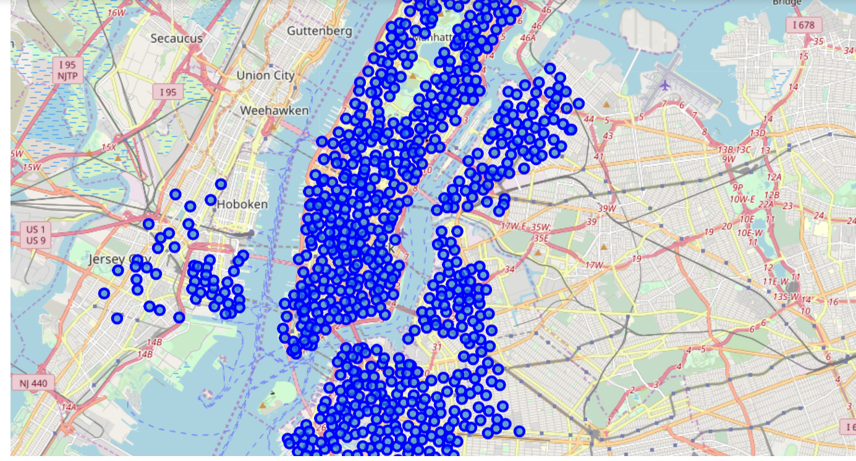
Map of Citi Bike Stations

Slide 5
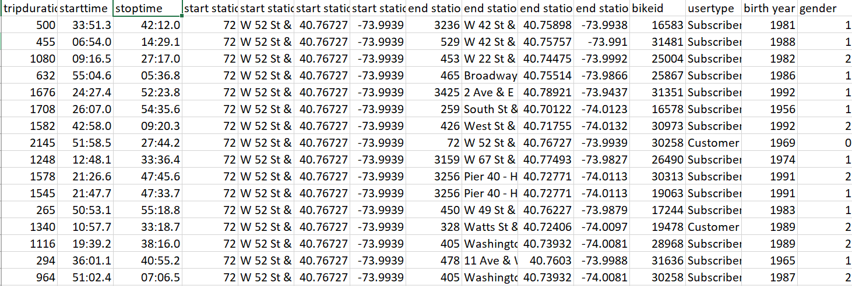
Excerpt of Data Spreadsheet

Slide 6
Methodology
Choose a start station, and analyze the data relative to past trips starting from that station:
Convert the data spreadsheet into a Pandas data frame, select only rows with chosen station as starting point
Clean-up data, remove features/columns that aren’t relevant, convert categorical variables
Check if there’s correlation between the selected features
Use geographical coordinates of the end stations and Foursquare to explore the area around these stations
Use kMeans to cluster the end stations and find common elements

Slide 7
Example – Input Data
Trips data of July 2018
Start station:
Name: Clinton Ave & Flushing Ave
ID: 343
Latitude, Longitude: 40.69794, -73.96986848
887 total trips
Only most travelled to stations are considered (at least 5 trips in the month), 42 in this case

Slide 8
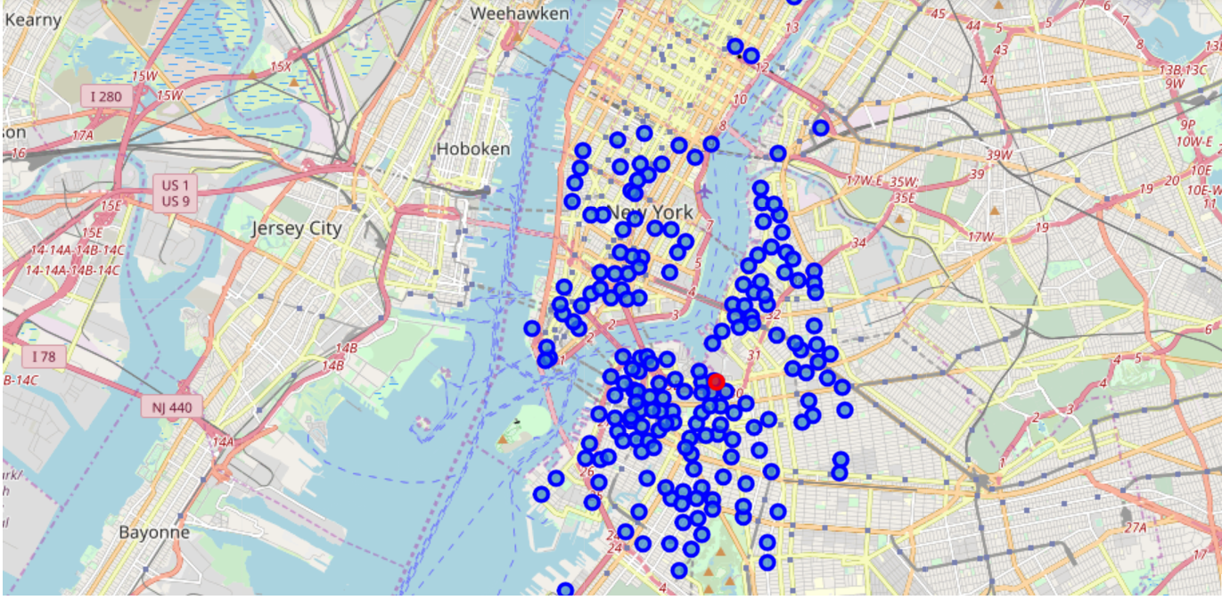
Example – Map of Start & Destinations

Slide 9
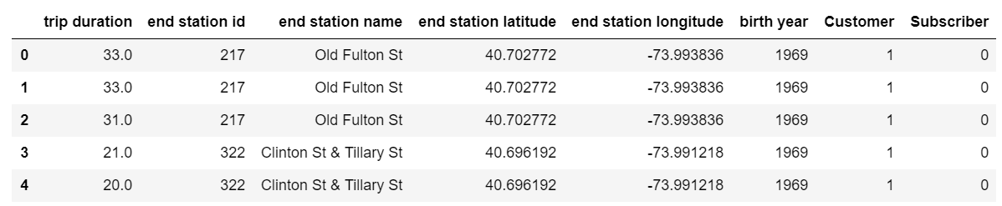
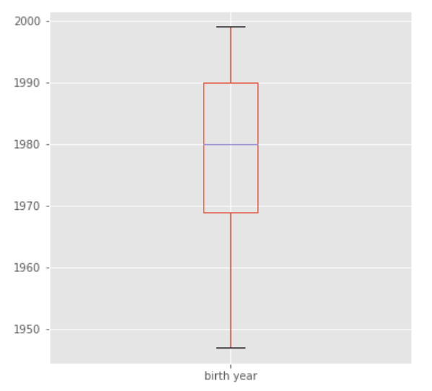
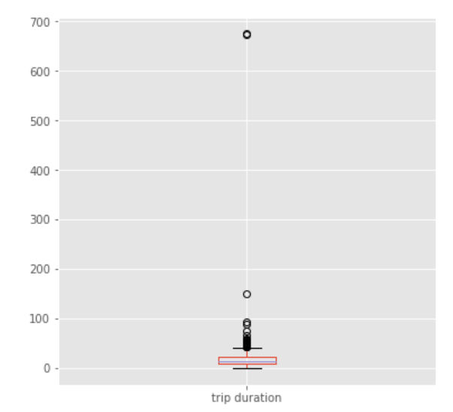
Example – Data Clean-up & Wrangling

Slide 10
Example – Data for Clustering
42 end stations
Total of 971 venues found by Foursquare, 213 belonging to a unique category
5 clusters used for KMeans

Slide 11
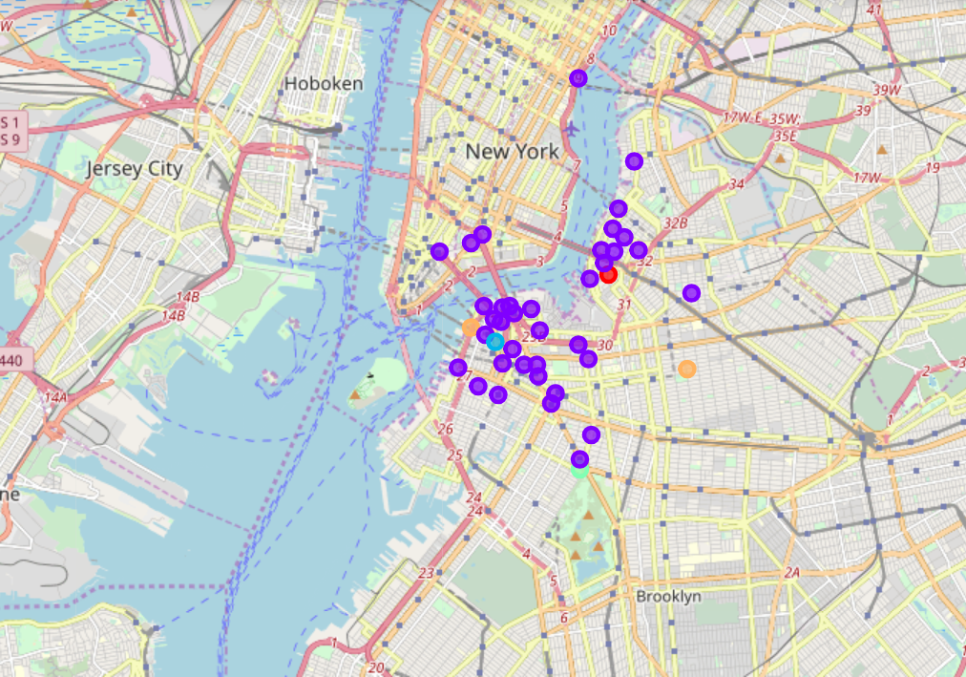
Example – Map of Clustering Results

Slide 12
Conclusions (1)
A procedure to plan a bike ride in NYC using the existing Citi Bike share network is suggested
The procedure can be generalized, by selecting different start stations, using data from different months/years, considering all the trips and not just the most common
In the proposed example, the most common destinations of the trips are within the same borough or close by
In the proposed example, most of the trips destinations are grouped in the same cluster and are characterized by having many food venues

Slide 13
Conclusions (2)
The other four clusters contain either one or two destination each
Other tests have been run using a different number of final destinations and slightly different number of clusters, leading to similar results: most of the end stations are grouped in the same cluster
In general, with different starting points and trips’ data considered, the results will be different, but still can be used to plan a trip

